Slide 1
POD as a Moral Experiment
Dr Liana Chase
Durham University
Open Dialogue in Devon
28th March 2024

Slide 2
The movement for pod
‘I’ve been doing all sorts of agitating.’
‘We’re trying to change whole systems’
‘the lingo we need to get the machine to support us.’
‘[CMHF] is a golden opportunity to implement Open Dialogue and we’ll continue to do our level best to do that…we will keep sowing seeds.’

Slide 3
A Moral Experiment
‘I think it’s kind of more ethical.’
‘‘It really sits with my values and Trust values.’
‘You can’t break ethics with Open Dialogue.’
‘An A, B, C of getting back to being human and humane.’
‘it's a humane way of encountering people’

Slide 4
Blind Faith?
‘evangelical’
‘cult-like’
‘only missing a pastor stood there with an 0800 number underneath it’
‘I think the fervour around it I found really overwhelming…given that it was, from our perspective, it was a study.’

Slide 5
‘We have pulled our hair at times with clinicians who have really advocated for Open Dialogue to extend its remit…to be offered on a wider basis. That could be incredibly unethical because if they go ahead and do that and then [the trial] comes back in 2024, 2025 and says, it’s no better… I don’t think there is the evidence at all.’

Slide 6
Ethical analysis in Public Health
How do we decide what is the right way forward for mental health services?

Slide 7
Utilitarianism
The ‘right’ action maximizes wellbeing for the greatest number of people
Need to measure consequences of action to judge its morality
‘Currently, the evidence in support of OD is of low quality, and randomized controlled trials are required to draw further conclusions. It is vital that an extensive evaluation…takes place because OD has already been adopted by many…services.’
(Freeman 2019, p. 46)

Slide 8
Virtue Ethics
The ‘right’ action embodies our ideas about what makes a good person and society
Embodying virtue is an end in itself
‘Morally and ethically it's quite hard to argue against the principles of it. So, what exactly are we worried about? Why is there even the ODDESSI trial? Because should we not just be doing this stuff?’
https://www.korumedicalspa.com/journal/be-the-change

Slide 9
The Moral meanings of caregiving
‘Caregiving ﻿is one of the foundational moral meanings and practices in human experience everywhere: it defines human value and resists crude reduction to counting and costing…’
(Kleinman 2012, p. 1550-51)

Slide 10
Jana, Clinician
‘We’re removing peoples’ rights, their liberties, we’re telling them you must take this medication, it’s going to get you better…I just didn’t want to become one of these nurses that were implementing all of that, really…I would never put my child into this situation…so why am I kind of condoning it to be okay?’
‘When Open Dialogue came along, I was like this is exactly how I want to work.’

Slide 11
Jeanine, Clinician
‘It’s a bit like jumping from factory farming to free-range organic farming. When animals are factory farmed in a sort of system that’s quite rigid and controlled, they just get used to it, don’t they? Then when they’re allowed out into the sunshine in the field, at first, they don’t want to go very far from their prison…. Initially they’re very tentative about Open Dialogue, because again they don’t quite trust it…Then you start to, as you get used to sort of the sunshine and fresh air you say, God this is amazing, why haven’t we done this before?’

Slide 12
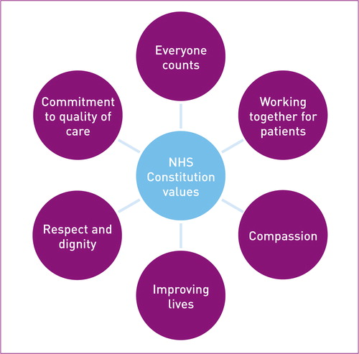
Conclusion: Meta-Ethical dilemmas
Outcomes vs. values
Moral dimensions of caregiving often impossible to measure
Anthropology can support public health decision-making

Slide 13
References
Kleinman A. Caregiving as moral experience. Lancet. 2012;380:1550–1. doi:10.1016/S0140-6736(12)61870-4.

