Slide 1
APOD in Devon: What Are We Learning?
Dr Liana Chase
Durham University
Open Dialogue in Devon
28th March 2024

Slide 2
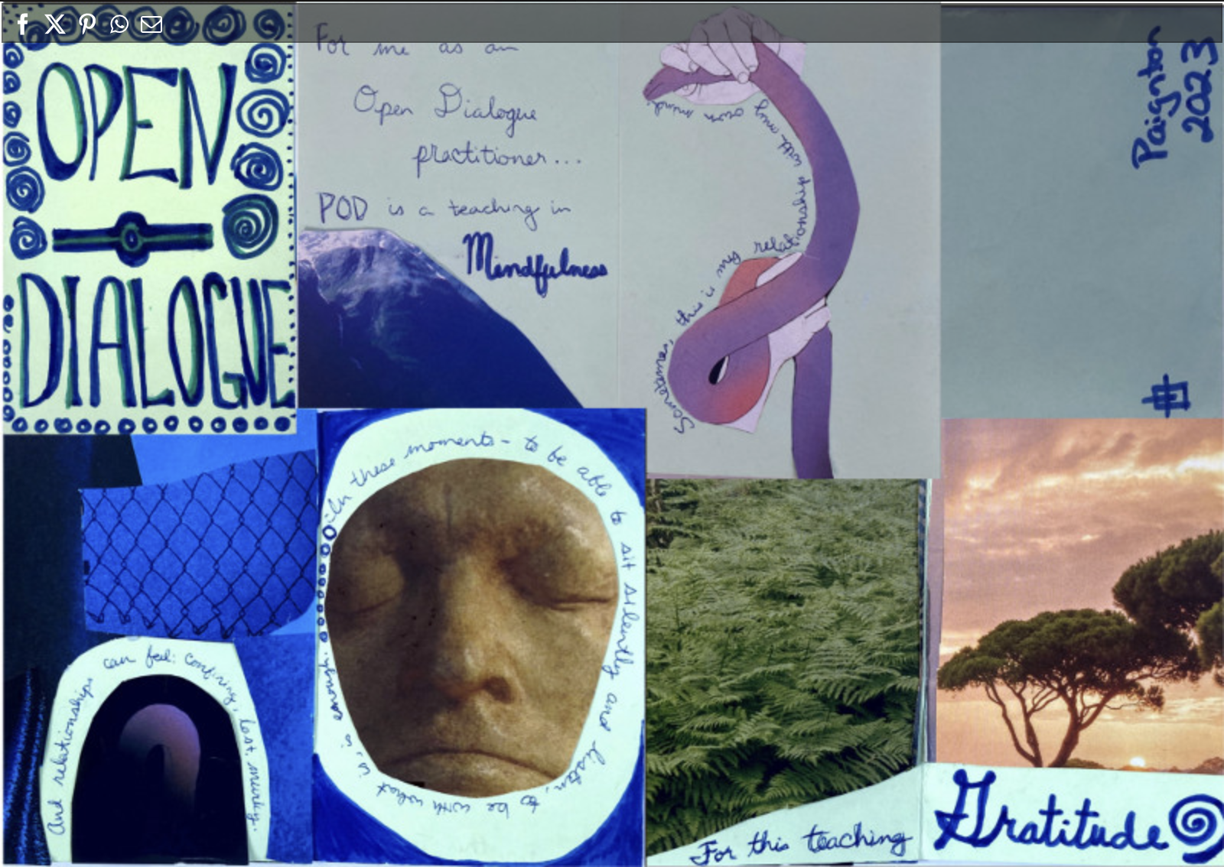
Fieldwork in Devon
2 ethnographers
18 months participant observation
Interviews with 50 people
Staff members
Mental health activists/advocates
People using services
Carers / network members

Slide 3
Anthropology & Open Dialogue
Applied Insights How can our findings on POD improve mental health services in Devon?
Theoretical Insights What does the POD experience teach us about mental health, recovery, and being human?

Slide 4
Applied Insights How can we improve mental health services in Devon?

Slide 5
Lived Experience and ‘Key Ingredients’
‘Not only do you get your say but what I liked about it was that you were talking to human beings.’
‘You're just in a safe space, and that is priceless.’
‘It's completely within your control.’
‘It’s given [my family members] insight to my illness that they wouldn’t have had before.
‘Being able to…get the help and support I need if I need it– that’s a massive part to keep someone like myself…on the straight and narrow without medication.’

Slide 6
Suggestions for Strengthening the Service
Better communication at the start of POD treatment about what is being offered and how POD affects eligibility for other services and referral processes
Improved informational leaflet on POD
Risks of slipping through the cracks or feeling unsupported without one consistent/responsible practitioner
Allocating named practitioner for each network

Slide 7
Other Topics Covered
Clinicians’ views on
Effectiveness
Safety and risk management
Waitlists and flow
Staff wellbeing & retention
Contextual challenges to implementing POD & strategies for addressing these
Recommendations on the future of POD in the NHS

Slide 8
Theoretical Insights What does the POD experience teach us about mental health, recovery, and being human?

Slide 9
What makes mental healthcare feel ‘human’?
…just being able to drop your professional gaze and just work with people as human beings.
[Conventional] therapy can give you someone that you can talk at, but there's no human element to it….
It makes you feel much more human– like you're not as broken as you thought you might have been.
You were talking to human beings.
Having somebody to speak to on a human level about things and not feeling judged has been helpful.
Dehumanizing effects of health bureaucracies organized around risk management
POD goes beyond aspirations to more person-centered care to establish conditions necessary
Spaces for deliberate ethical reflection
Reorganizing care provision
Rethinking the role of clinician

Slide 10
What does it take to tolerate uncertainty in clinical practice?
Health systems organized around a conception of mental illness as stable, knowable, and curable
Tolerating uncertainty is a form of skilled labor involving both learning and unlearning
Systemic and structural conditions – including professional role – affect the ability to tolerate uncertainty
Tolerating uncertainty is a form of action with real consequences

Slide 11
What does the POD experience tell us about the moral dimensions of mental healthcare?
….to be discussed in Session 2

