Slide 1
‘Finding mutuality in liminality’: The experiences of peer support workers in Open Dialogue and beyond Kiara Wickremasinghe, SOAS University of London 644916@soas.ac.uk APOD Conference Devon 28th March 2024

Slide 2
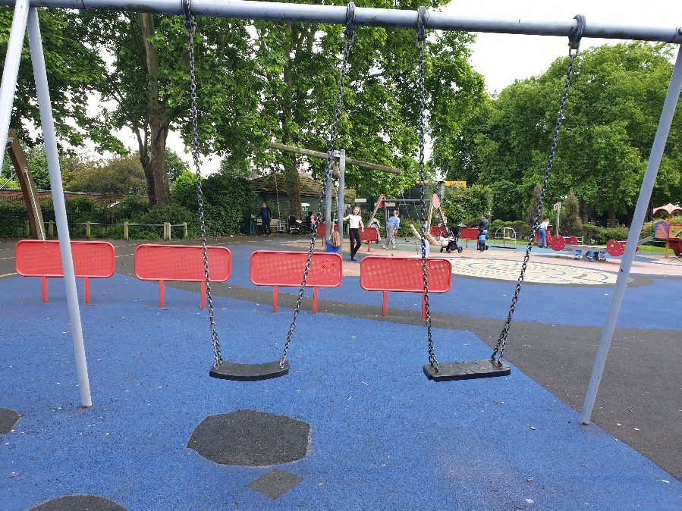
1. Vignette

Slide 3
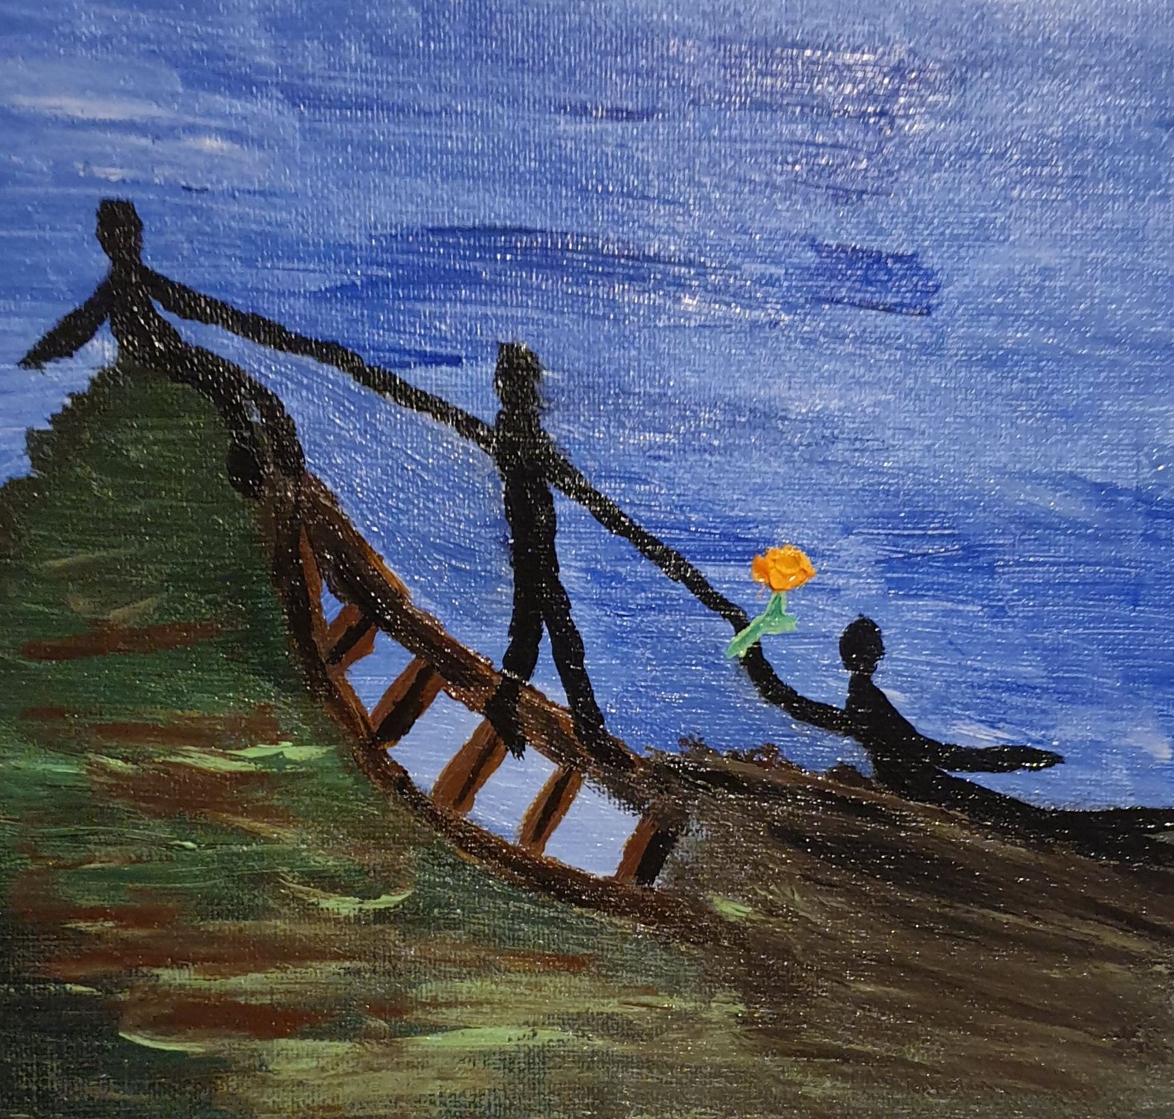
A somewhat ugly painting(!), but I was trying to capture a sense of connection here, with peer support workers as a ‘bridge’ between clinicians and service users, offering hope but also positioned precariously and facing conflicting demands.
2. Introducing my paper

Slide 4
“not just an event that takes place in time, but one that actually generates or gives time” (Dikeç et al., 2009, p. 11)
3. An anthropology of friendship?
“construction of a moral universe to which both host and guest agree to belong” (Selwyn, 2000, p. 19)
“intimate workers” (Myers, 2015, p. 132)

Slide 5
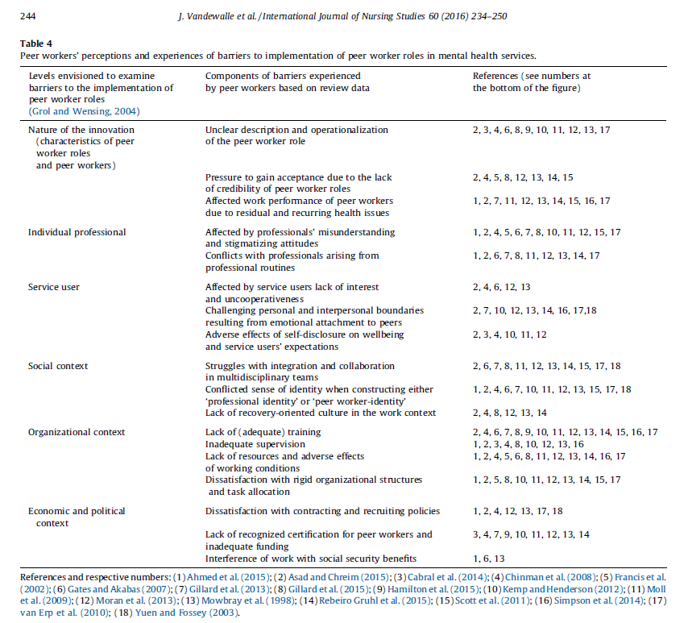
4. A liminal institutional role?

Slide 6
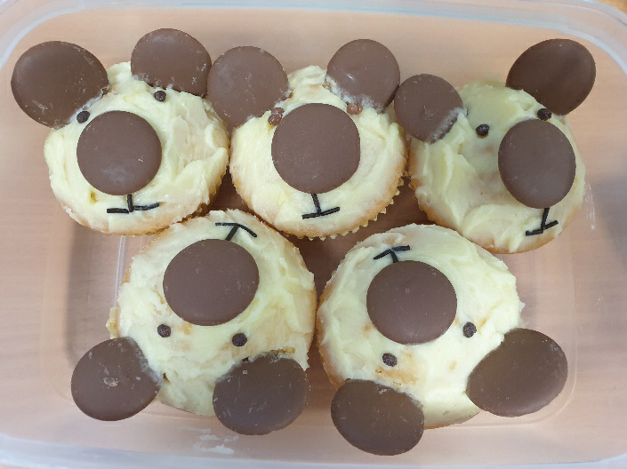
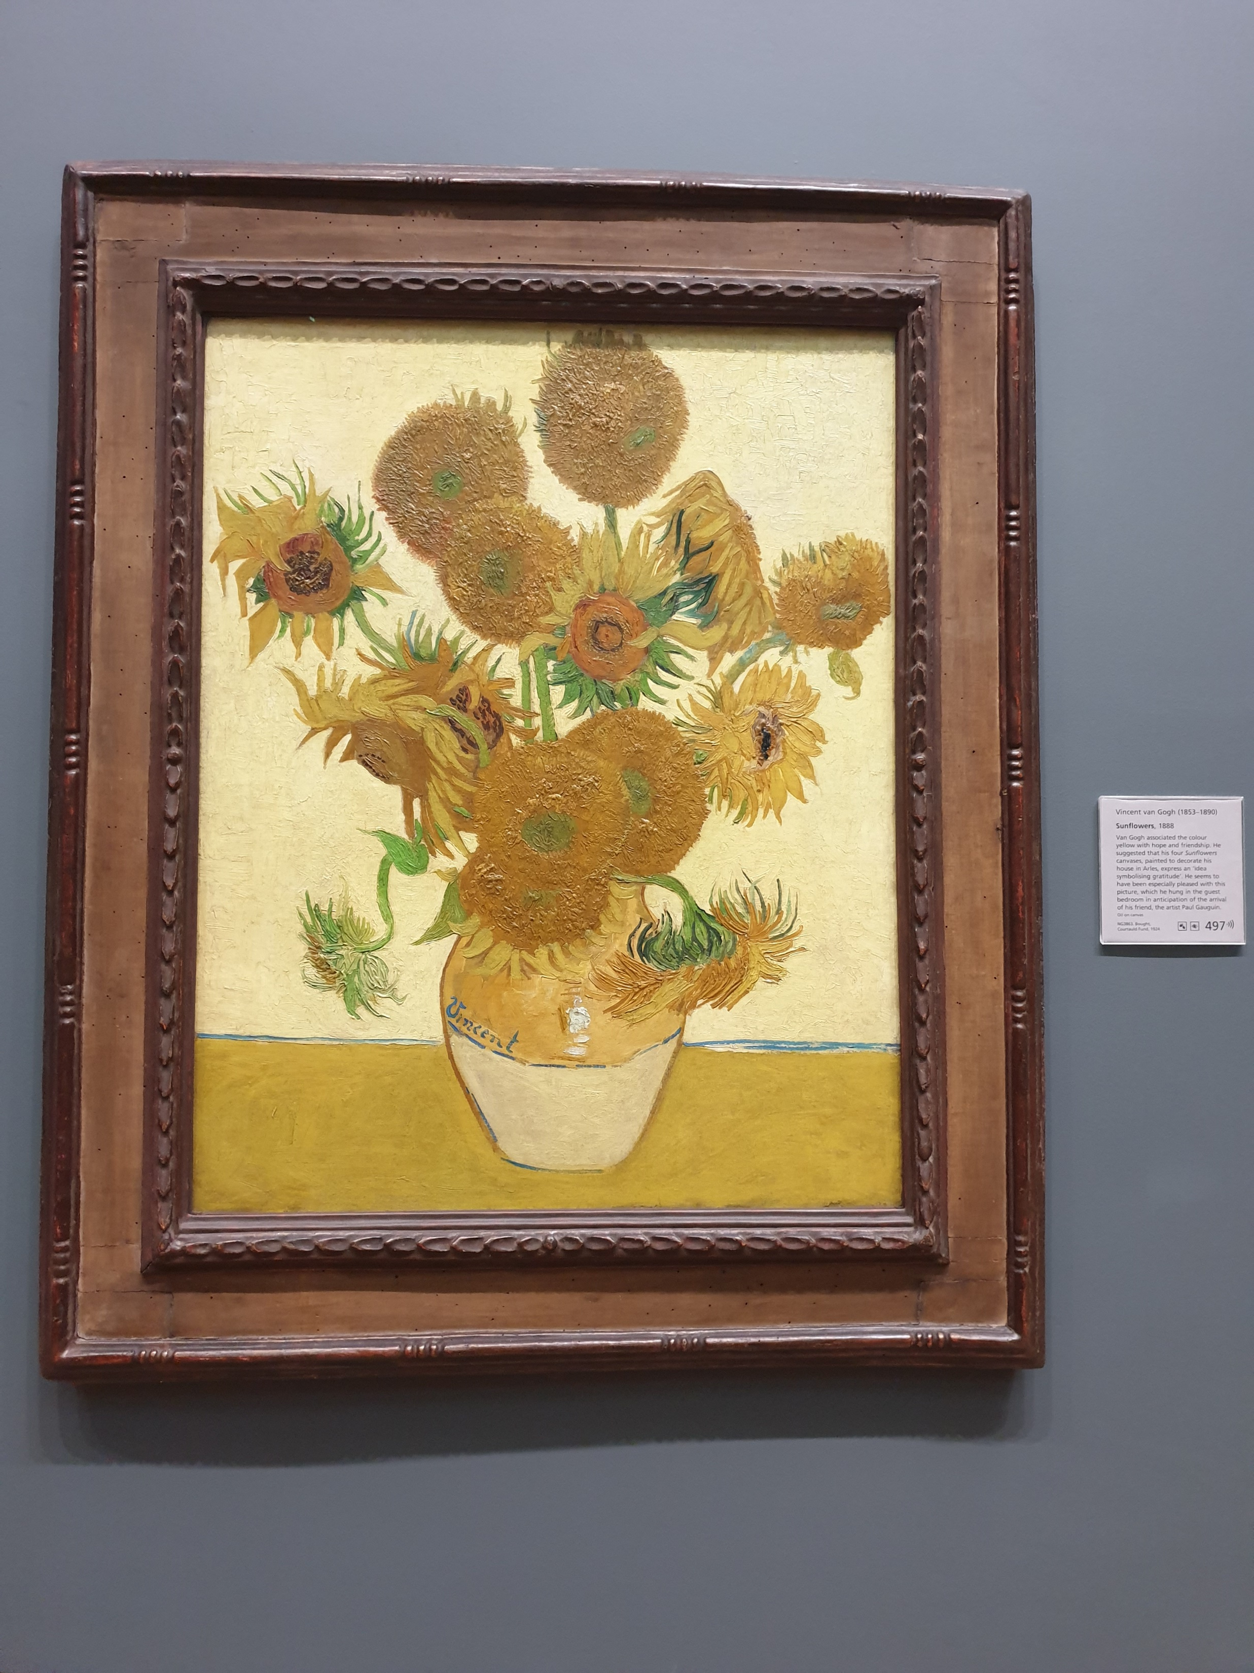
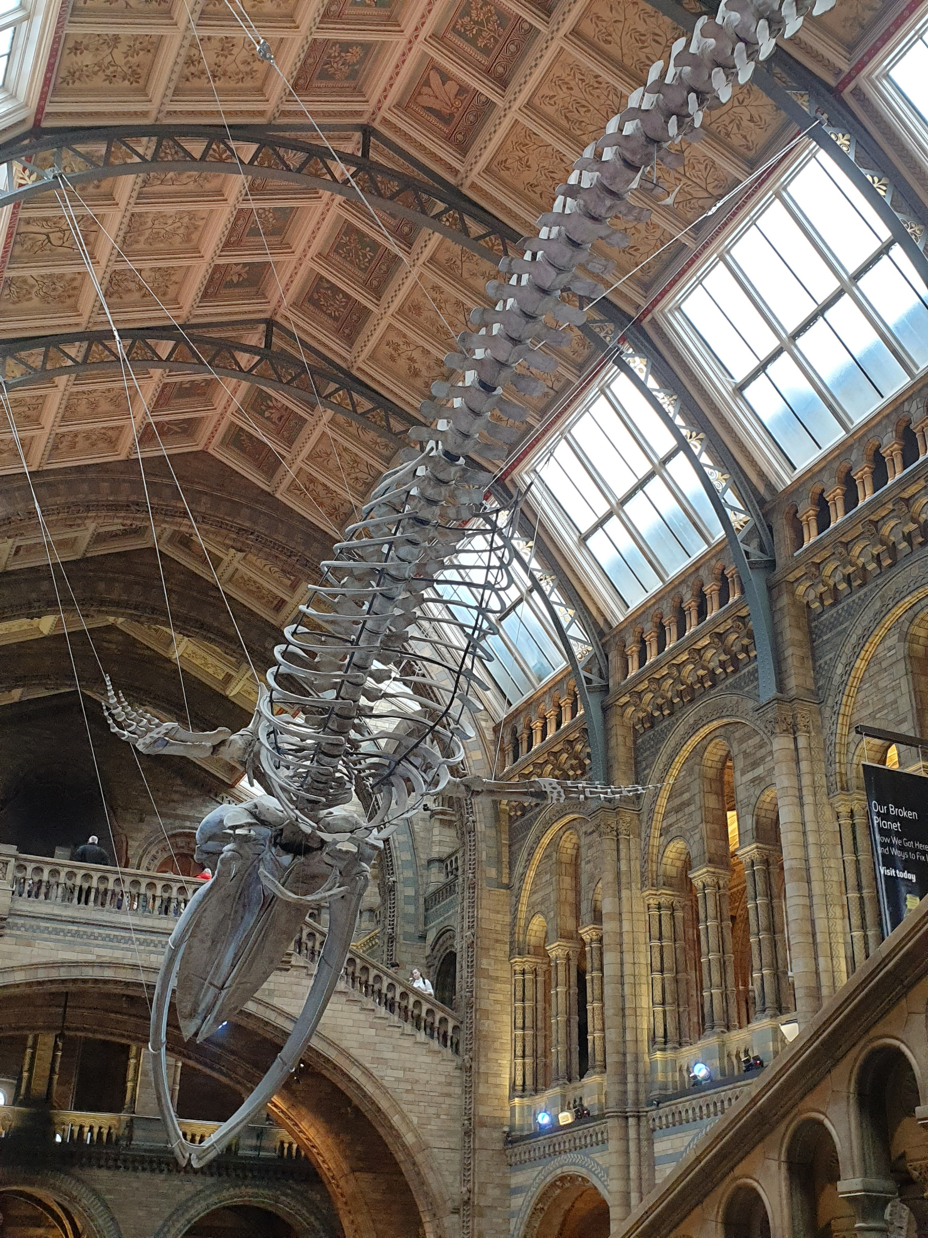
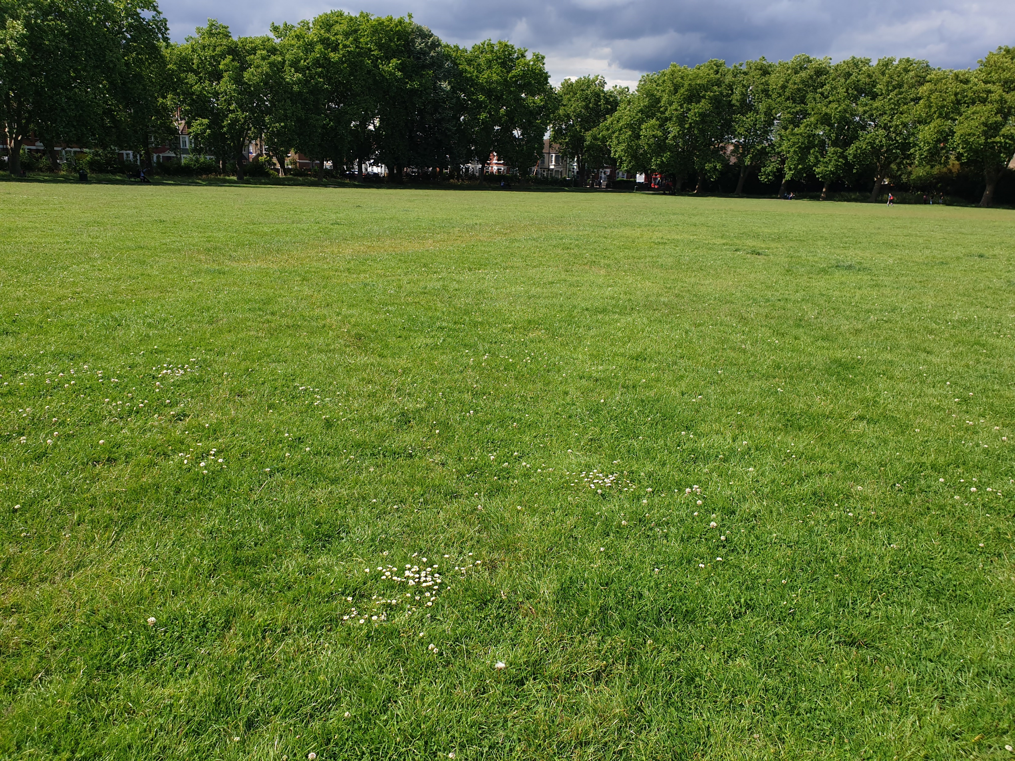
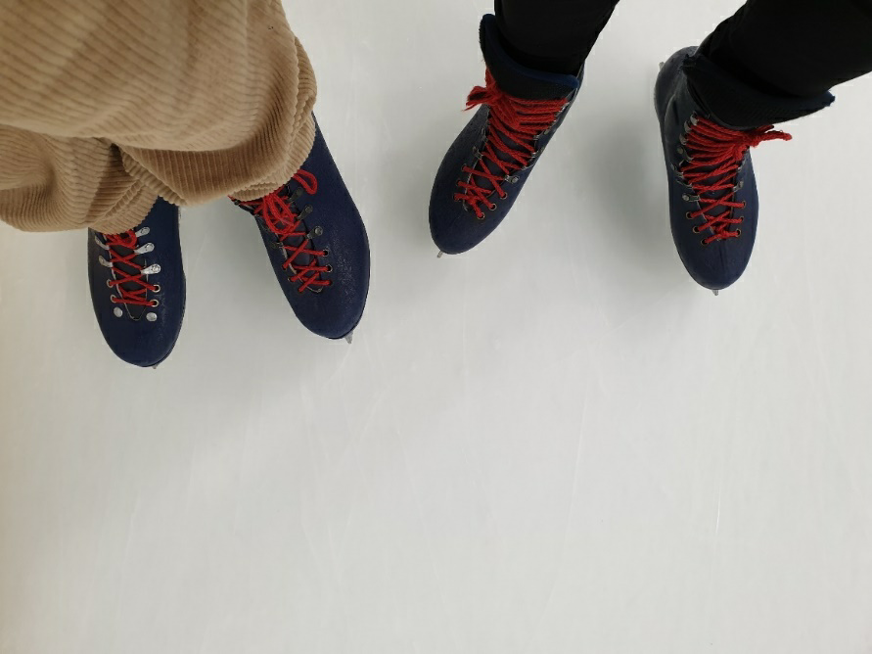

Slide 7
“She wants to look at losing weight, so our one-to-ones are in the park on the exercise machines. I come in with my tracksuit and t-shirt and we go and get exercising. Then other people, it’s about sitting and having a conversation. Then there’s one who will write a poem and they want to use our time to read it out loud to me because they never let anyone read their stuff.” (Raashi)
“So when I work with a patient I go in and if I’ve never met them before, I say, let’s have a chat now about what’s gone on for you, and we’ll write some stuff down on a big piece of paper. What do we need to work on? What do we need to talk about? I tell them my own experiences from my heart and my own lived experiences in my way.” (Hazel)
“A lady I was working with – we’d go for a walk or we’d go up to Gregg’s, or we’d take her dog for a walk.” (Lina)

Slide 8
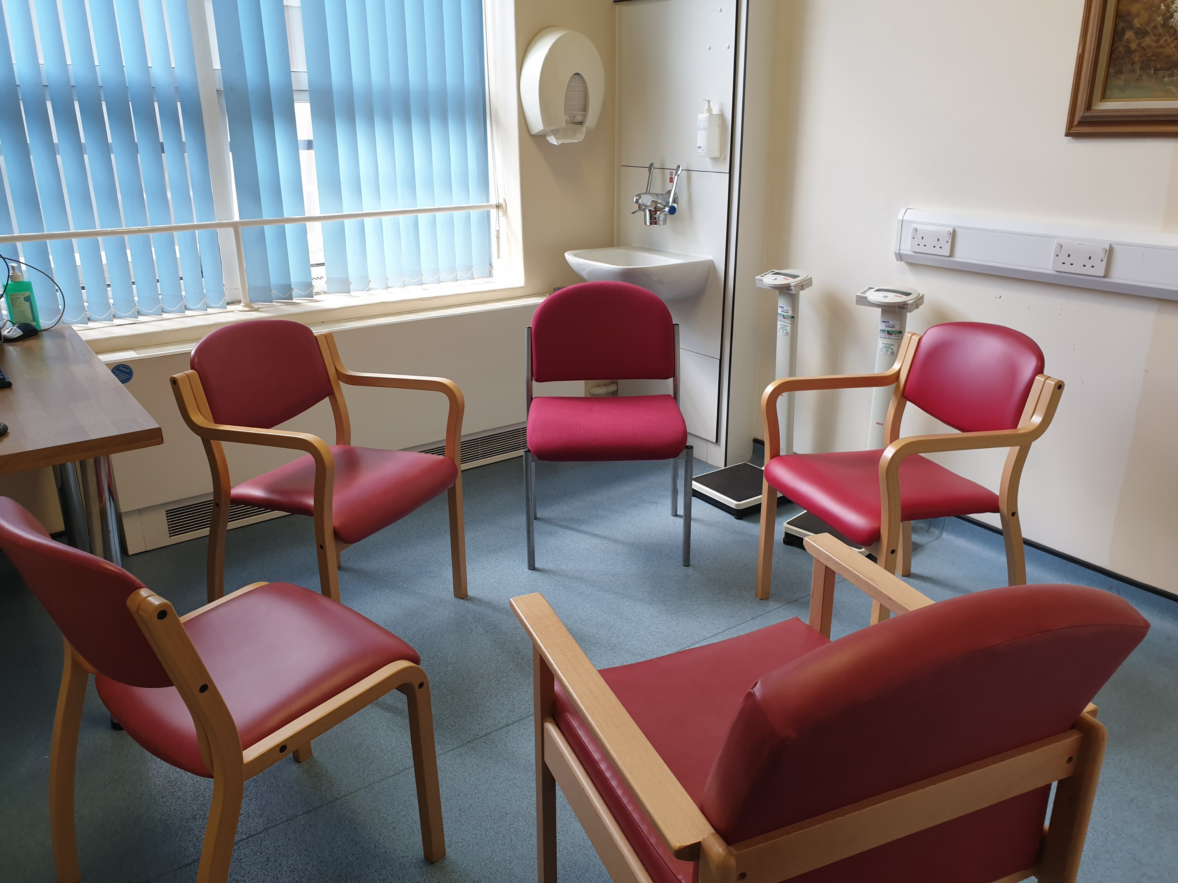
5. Institutional crossovers

Slide 9
In an Open Dialogue team, peer support workers perform dual roles: meeting service users in one-to-one peer support contexts; and co-facilitating network meetings alongside another practitioner. Sometimes there is a tension in performing these dual roles but overall, the one-to-ones build trust and enhance the quality of dialogue in network meetings.
Peer support workers have different styles, practices and creativities when carving out spaces for mutual care-giving. They are not as disenfranchised in the workplace as portrayed in literature and may in fact wield different kinds of power.
Besides being a peer support worker and Open Dialogue practitioner, being primarily an anthropologist conducting fieldwork in this setting contributes another layer of liminality.
6. Some conclusions

