Slide 1
Anthropological Study of
Peer-supported Open Dialogue in the NHS
David Mosse
Professor of Social Anthropology

Slide 2
APOD Team
David Mosse (SOAS)
Kiara Wickremasinghe (SOAS)
Liana Chase (Durham University)
Ruth Kloocke (Barnet, Enfield & Haringey Mental Health NHS Trust)
Molly Carroll, Systemic Family Therapist,
Darren Baker (Barnet, Enfield & Haringey Mental Health NHS Trust)
Bethan Cramer (Devon Partnership Trust)
Milena Wuerth (SOAS)

Slide 3
Open Dialogue
Non-diagnostic
Dialogue
Social-network-based
Polyphony
Narrative

Slide 4
Open Dialogue Principles
Razzaque R. and Stockmann T. (2016) An introduction to peer-supported open dialogue in mental
healthcare. Bjpsych Advances 22(5): 348–356
Way of organising mental health services
Therapeutic intervention

Slide 5
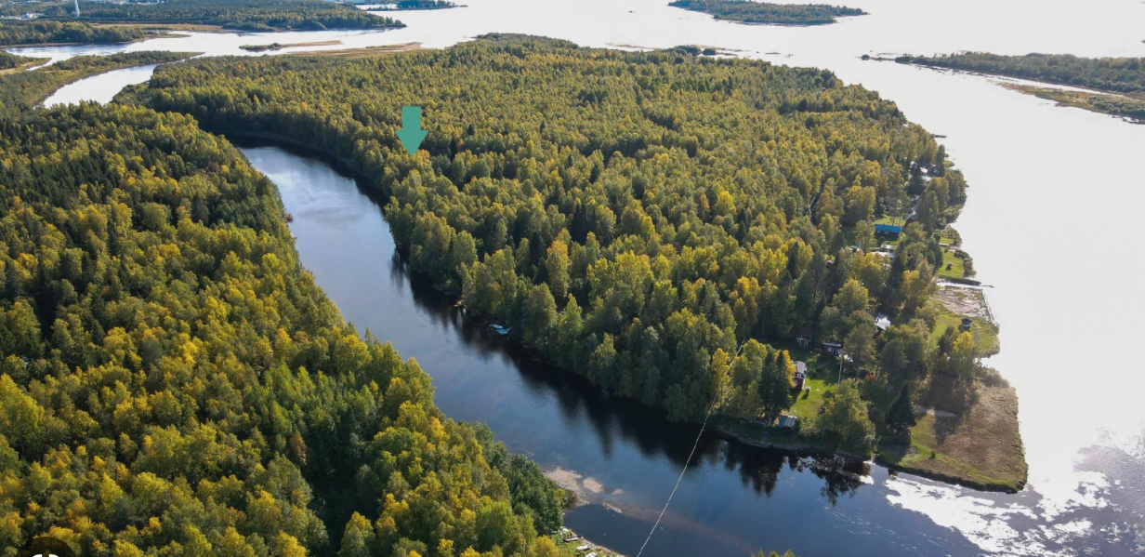
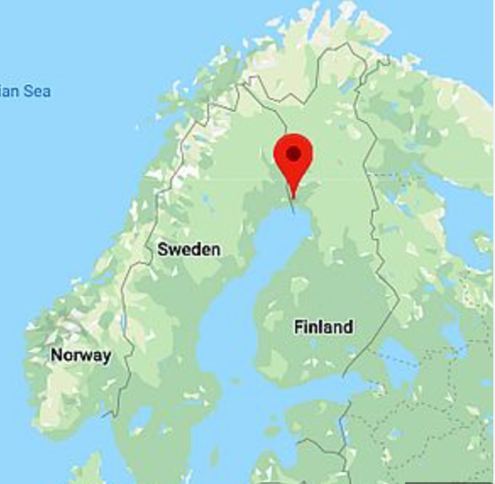
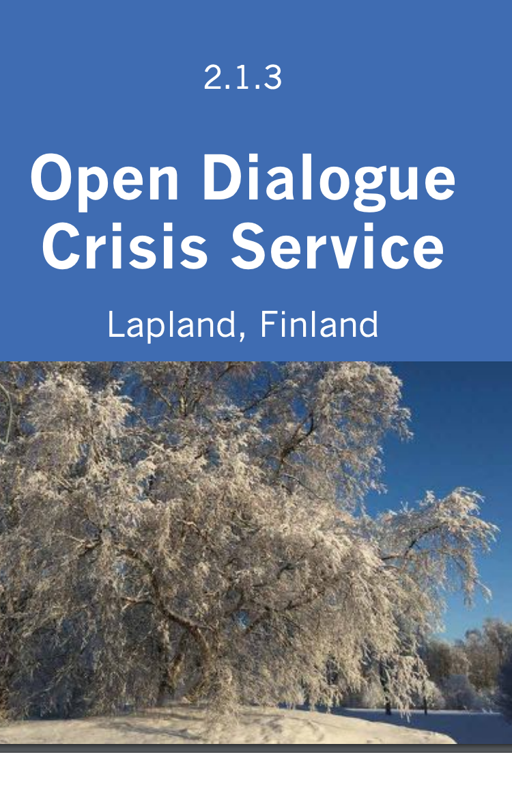
TORNIO,
FINLAND

Slide 6
Open Dialogue: Development and Evaluation of a Social Network Intervention for Severe Mental Illness

Slide 7
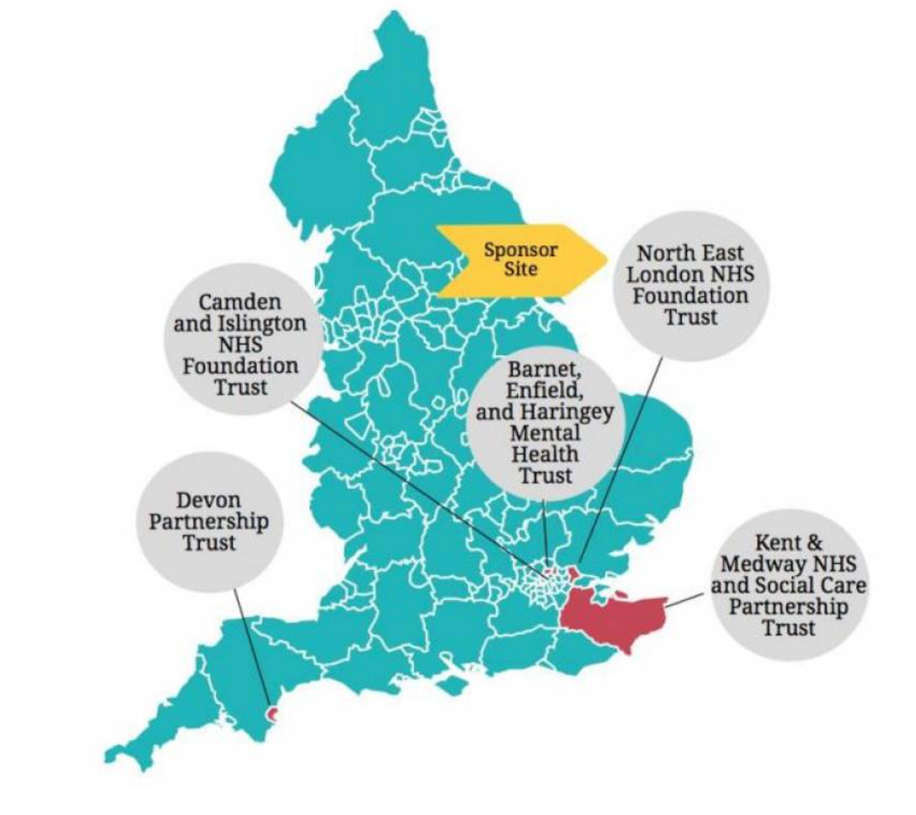
NIHR trial: 5 NHS Trusts
5-year trial-ODDESSI (Development and Evaluation of a Social Network Intervention for Severe Mental Illness)
Multicentre (cluster randomised) RCT
1º outcome measures - time to relapse
Organisational change process evaluation
Evaluation of service user and network experience
https://www.ucl.ac.uk/pals/research/clinical-educational-and-health-psychology/research-groups/oddessi/oddessi-trial

Slide 8
What are we studying?
Complement to ODDESSI
Actual practices and experiences of Open Dialogue (clinicians and clients)
Treatment experience: what lies between procedure and outcome (Csordas)
Human and contextual factors influencing POD
Description: open to the unexpected, unintended, informal, the everyday
Things that may not be in the POD model; important to future implementation of the approach

Slide 9
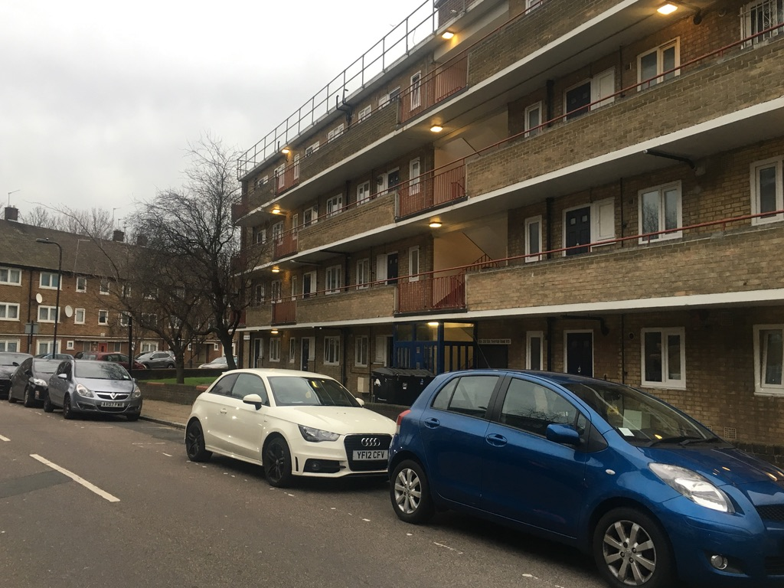
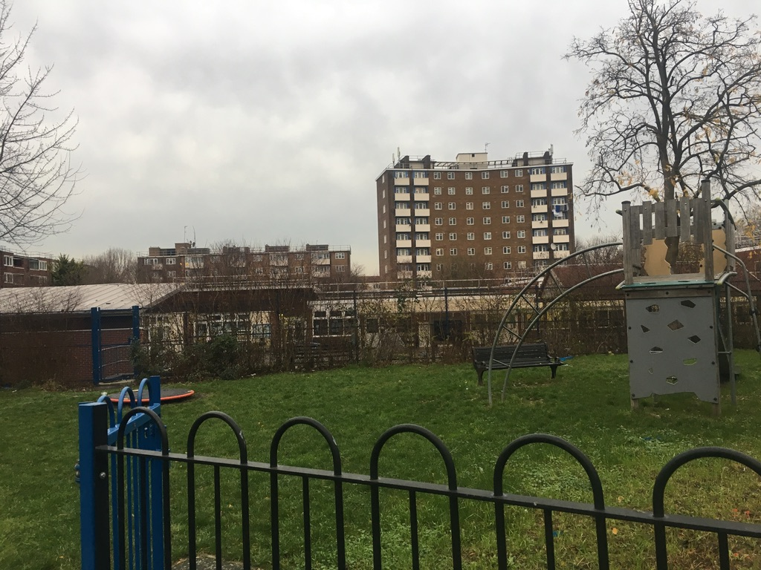
The study
Ethnographic team
Immersive participation observation as members of POD teams:
2 Sites
Inner London
Coastal Devon
Research Design

Slide 10
Crisis team
Inpatient teams
Peer-Supported
Open Dialogue
POD Team
Community team
Early intervention psychosis team (EIS)

Slide 11
APOD Team
David Mosse (SOAS)
Kiara Wickremasinghe (SOAS)
Liana Chase (Durham University)
Ruth Kloocke (Barnet, Enfield & Haringey Mental Health NHS Trust)
Molly Carroll (Barnet, Enfield & Haringey Mental)
Darren Baker (Barnet, Enfield & Haringey Mental Health NHS Trust)
Bethan Cramer (Devon Partnership Trust)
Milena Wuerth (SOAS)

Slide 12
What is an Anthropological Approach?
‘The contribution of anthropology to the study of Open Dialogue: ethnographic research methods and opportunities’
David Mosse, Darren Baker , Molly Carroll , Liana Chase , Ruth Kloocke2, Kiara Wickremasinghe1, Bethan Cramer4, Keira Pratt-Boyden1 and Milena Wuerth1
Frontiers in Psychology, May 2023 doi: 10.3389/fpsyg.2023.1111588

Slide 13
Relationships between staff and clients their family/networks
Relationships among staff in teams
Relations between
relations
Relationships with the wider healthcare “system”
Social networks - relations of kinship and in the community,

Slide 14
“Its an exciting invitation to unburden yourself of the professional role of being a doctor and just being a person”
Psychiatrist
“So, I had to unlearn my script in my head and the next question to ask …scary”
“A light bulb moment ..my patients are no different from me, from us.”
Psychiatrist
Psychiatrist
Nurse
Psychiatrist
POD clinicians
experience
“I put my decision-making self on hold”
“I get a …bigger perspective about the networks, you know and the people around them”
Care coordinator

Slide 15
“When I came out of hospital there was this group of people [staff and family] which always almost catches you… I suffer less knowing that there are people who just witness my condition and are there and stand by…not like you’re going to this one psychiatrist behaving very clinically, you have a group of people… a micro-community interested in your wellbeing…”
§
When staff reflect in front of clients:
“It's less about what you said content-wise, but [seeing how my emotions] were being transferred and impacted on those sitting around me. “In psychosis somehow your brain is oscillating on a different mode so you can’t sometimes process emotions properly or ... you’re disconnected in a certain way from your emotions. It was very helpful for me actually to witness... a conversation [taking place] about how it made other people feel when I talked, for example about my mother or other traumatic experiences.”
POD client experience
nowing
“Like having my session played back to me like a video... putting it together for me. Even if staff got it completely wrong! They’re putting themselves in my position”.
Psychiatrist

Slide 16
“Learning to share with colleagues helps us be more open with patients... It changes the way we view each other and our clients”
Relationships in the POD team
Psychiatrist
“you can say, this really upset me…and hear colleagues response ”
Nurse
“…being on the wards, there are still certain situations where I find myself a little bit stuck and the approach of reflecting in front of people and reflecting with colleagues I think has been really helpful. …I've used the InterVision group to discuss my concerns about a dynamic or a relationship that I've found myself in with a patient x and that's sort of actually helped to unstick it”

Slide 17
Relationships with the wider ‘system’

Slide 18
Demands of the wider systems of governance, responsibility and procedural accountability
Effects of the pressure on the system
Conditions of the wider organisation produces unequal experiences of POD

Slide 19
Research Design
R
Aspects of Open Dialogue | Sub-questions | Ethnographic Fields
1. A dialogical model of treatment | 1. How are OD principles translated into practice? | Clinical encounters
2. A social network approach | 2. What is the link between what happens in therapeutic settings and in the social networks and structural constraints of everyday life in urban localities? | Community social networks, everyday experience of structures of disadvantage in an inner London borough
3. A way of organising mental health services | 3. What are the historical antecedents and organisational requirements of OD? | The NHS institutional system

